Slide 1

Exchange Types, Queue Types, Durable Queues & Message Persistence

Slide 2
Agenda
What is an Exchange
Direct Exchange
Fanout Exchange
Topic Exchange
Header Exchange
What is Queue
Types of Queue
Queue Durability

Slide 3
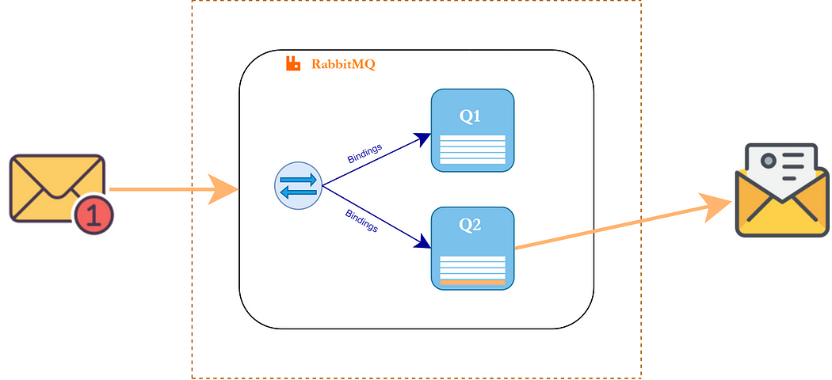
What is an Exchange?
An Exchange is a core RabbitMQ component that receives messages from producers and routes them to queues based on certain rules.
RabbitMQ
3

Slide 4
How Exchanges Work
Producer publishes to an exchange: A producer application sends a message to a specific exchange, optionally including a "routing key" and other message headers.
Exchange receives the message: The exchange gets the message from the producer.
Routing logic applied: The exchange then applies its routing logic to determine which queues should receive a copy of the message. This logic depends heavily on the exchange type and the "bindings" that have been established.
Messages routed to queues: Based on the routing logic, the exchange routes the message (or copies of it) to the appropriate bound queues.
Consumers consume from queues: Finally, consumers retrieve and process messages from the queues.
RabbitMQ
4

Slide 5
Key Concepts
Concept | Description
Binding | Link between an exchange and a queue with a routing rule
Routing Key | A string used by the exchange to decide which queue(s) to route to
Exchange Type | Determines the routing behavior (e.g., direct, topic, fanout)

Slide 6
Direct Exchange
Routing Logic: Routes messages to queues whose binding key exactly matches the routing key of the message.
Use Case: Ideal for unicast routing (one message to one specific queue) or distributing tasks to specific workers.
.

Slide 7
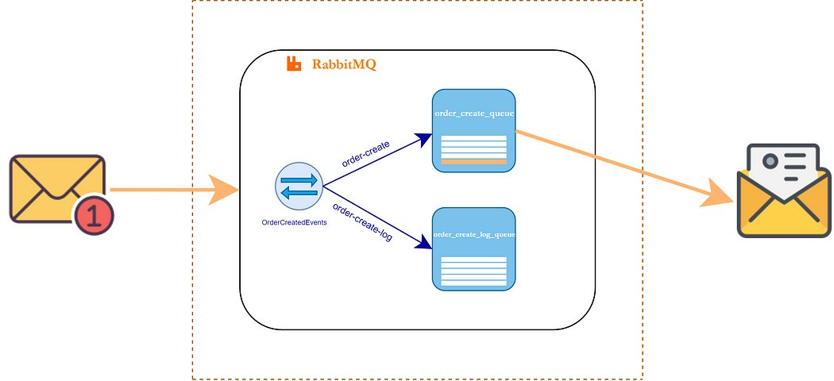

Slide 8
Fanout Exchange
Routing Logic: Routes a copy of every message it receives to all queues bound to it, regardless of the routing key. The routing key is completely ignored.
Use Case: Ideal for broadcast routing, where a single message needs to be delivered to multiple consumers or services. Examples include real-time sports updates, chat applications, or system-wide notifications.

Slide 9
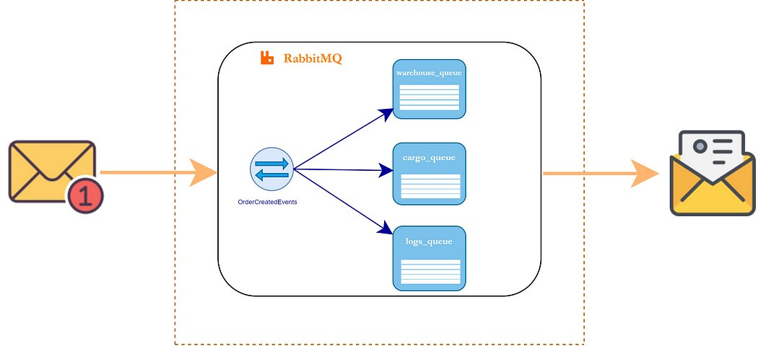

Slide 10
Topic Exchange
Routing Logic: Routes messages based on a pattern match between the message's routing key and the routing (binding) pattern used at binding time.
Pattern Matching:
* (asterisk): Matches exactly one word in a specific position of the routing key.
# (hash): Matches zero or more words.
Routing keys are typically a list of words separated by . (periods), e.g.,logs.warning.system.
Use Case: Flexible for publish/subscribe patterns where consumers are interested in specific categories or hierarchies of messages. For example, a consumer might subscribe to logs.# to get all log messages, or logs.error.* to get error messages from any source.

Slide 11
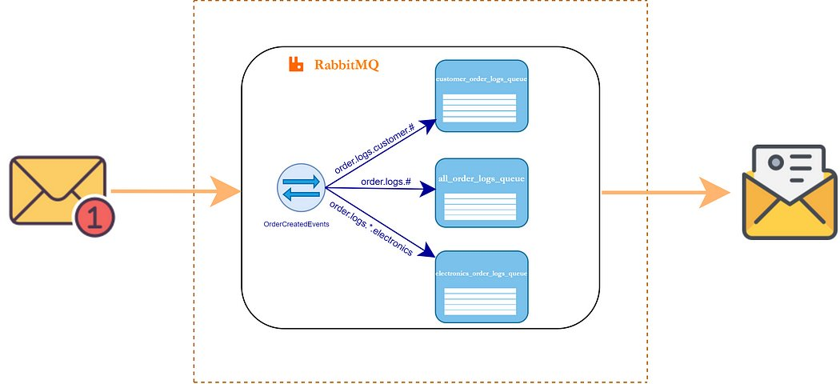

Slide 12
Headers Exchange
Routing Logic: Routes messages based on the message header attributes rather than the routing key.
How it works: Bindings for headers exchanges specify a set of key-value pairs(headers) and an x-match argument (either all or any).
x-match=all: The message must have all the headers specified in the binding, and their values must match.
x-match=any: The message must have at least one of the headers specified in the binding, and its value must match.
Use Case: Useful for more complex routing scenarios where dynamic attributes in the message headers are the primary routing criteria.

Slide 13
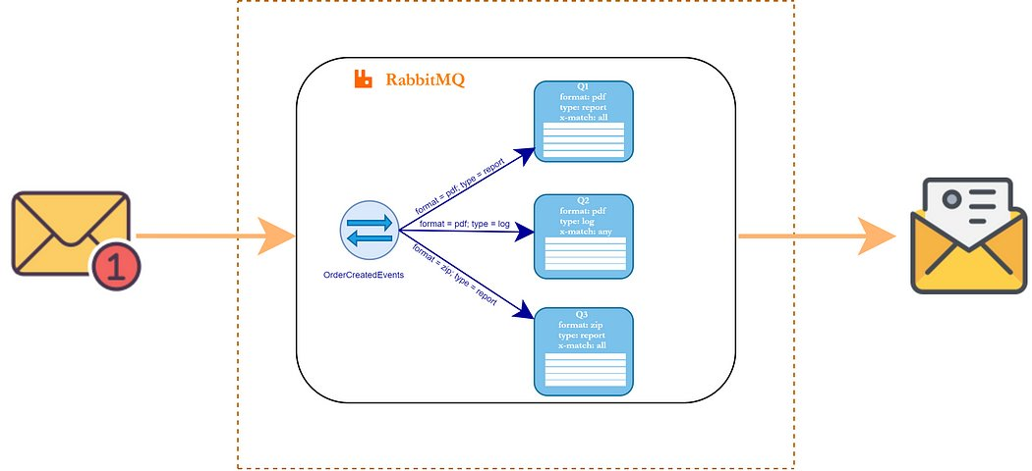

Slide 14
What is Queue ?
A queue is a buffer that stores messages until they are consumed by a receiver (consumer).
Why is it used?
To decouple producers and consumers (they don’t have to run at the same time).
To balance load (multiple consumers can process messages from the same queue).
To improve reliability by storing messages even if the consumer is temporarily down.

Slide 15
Types of Queue
Classic Queues : Traditional RabbitMQ queues. Store messages in memory or disk.
Quorum Queues : Use Raft consensus for replication and fault tolerance.
Stream Queues : Newer, for very high-throughput, replayable messaging (v3.9+)

Slide 16
1. Classic Queues
Description: The original and default queue type in RabbitMQ, designed for simplicity and high throughput.
Characteristics:
1. Non-replicated, stored on a single node.
2. Follows FIFO (First-In, First-Out) order.
3. Supports features like message and queue TTL, queue length limits, message and consumer priority, dead-letter exchanges, and QoS prefetch.
4. Can be durable (persisted to disk) or transient (in-memory).
Use Cases: Suitable for applications where high availability and data safety are less critical, but high performance and low latency are required, such as real-time systems or stateless applications
RabbitMQ
16

Slide 17
2.Quorum Queues
Description: A newer, replicated queue type focused on data safety, consistency, and high availability.
Characteristics:
1. Uses the Raft consensus algorithm for leader-follower replication.
2. Messages are replicated across multiple nodes; acknowledged only after a majority (quorum) confirm.
3. All messages are persistent by default.
4. Designed to survive node failures with automatic leader election.
5. No single point of failure.
Use Cases: Ideal for mission-critical systems where message loss or downtime is unacceptable, such as financial transactions or order processing
RabbitMQ
17

Slide 18
3.Stream Queues
Description: Designed for high-throughput, append-only workloads with non-destructive read semantics.
Characteristics:
1. Replicated structure, optimized for scenarios requiring message replay and persistence.
2. Supports high throughput and large log-like data streams.
3. Clients must connect to nodes hosting the stream replica.
Use Cases: Suitable for event sourcing, data pipelines, and applications needing message replay or log compaction
RabbitMQ
18

Slide 19
Queue Durability
Queue durability in RabbitMQ refers to the ability of a queue to survive broker (server) restarts, ensuring that the queue definition and, under certain conditions, its messages are not lost if the RabbitMQ node is rebooted or crashes
Types of Queue Durability
1. Durable Queue
2. Transient (Non-Durable) Queues
RabbitMQ
19

Slide 20
Durable Queues
The queue's metadata (its definition and properties) is stored on disk.
The queue will be automatically recovered after a broker restart.
To ensure messages in the queue also survive restarts, messages must be published as "persistent" in addition to the queue being durable.
Commonly used for critical applications where message loss cannot be tolerated
RabbitMQ
20

Slide 21
Transient (Non-Durable) Queues
The queue exists only in memory.
The queue and any messages it contains will be lost if the broker restarts or crashes.
Suitable for temporary workloads or scenarios where message loss is acceptable
RabbitMQ
21

